Slide 1



Slide 2
About today…
React
Error Boundaries

Slide 3
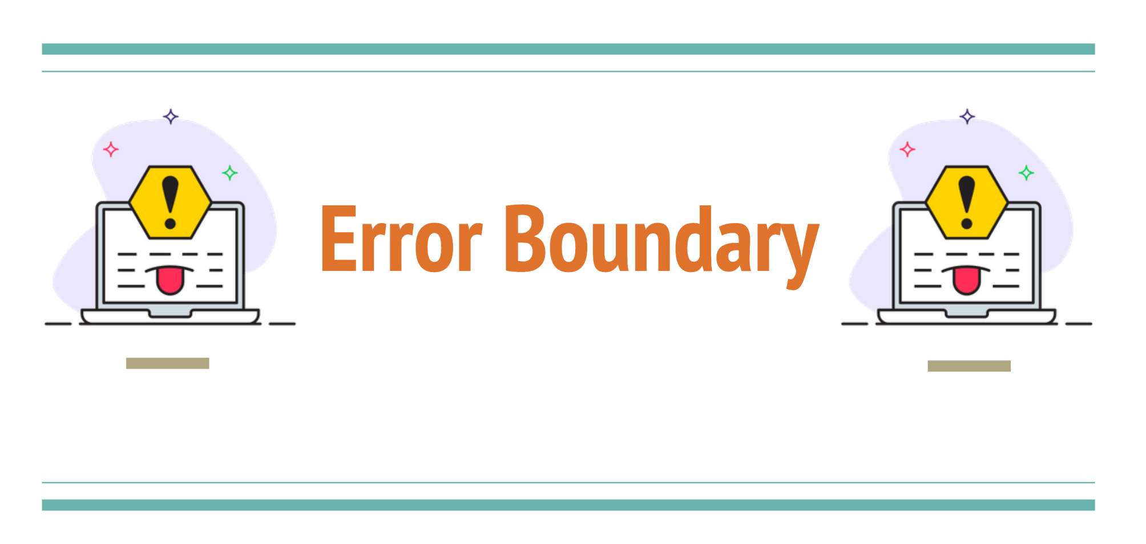

Slide 4

Introduction to Error Boundaries
Intro
Error boundaries are React components that catch JavaScript
errors in their child component tree
They log errors and display a fallback UI instead of crashing the whole app
Error boundaries only catch errors in the rendering phase, lifecycle methods,
and constructors

Slide 5

Why Use Error Boundaries?
Intro
Improve user experience by displaying a fallback UI
Prevent entire app crashes due to errors in a part of the component tree
Log errors for debugging and fixing issues

Slide 6

Setting Up react-error-boundary
Install the Library
Import the Components

Slide 7
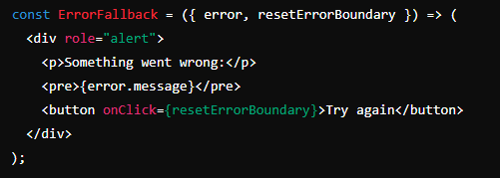
Creating an Error Fallback Component
Define the Fallback UI

Slide 8
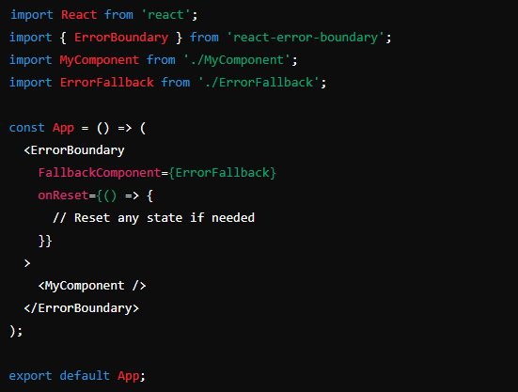
Wrapping Components with Error Boundary
Wrap Your Components

Slide 9
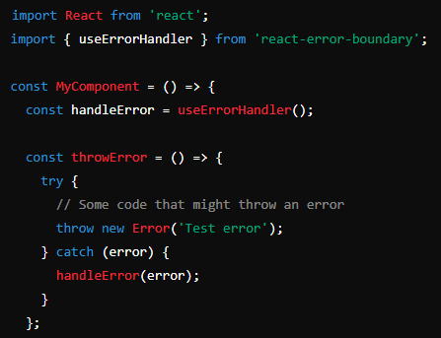
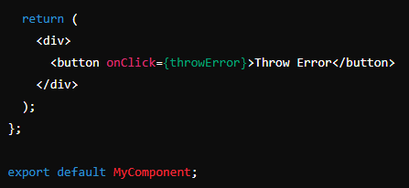
Handling Errors Locally with useErrorHandler
Use the useErrorHandler Hook

Slide 10

What is an error boundary in React?
React component that catches JavaScript errors in its child component tree, logs those errors, and displays a fallback UI instead of the component tree that crashed
Can error boundaries catch errors in event handlers?
No, error boundaries cannot catch errors in event handlers. To catch errors in event handlers, you need to use try-catch blocks within the event handler
How do you define an error boundary using the react-error-boundary library?
Using the ErrorBoundary component from the react-error-boundary library and provide a fallback UI component via the FallbackComponent prop

Slide 11


Slide 12

Task
Build a simple user profile application that displays user information and handles potential errors using the react-error-boundary library

